Slide 1
X17 Search at EAR2
Dylan Neff
University of Manchester & INFN Legnaro
3/24/2026

Slide 2
Overview
X17 Measurement at n_TOF
MM Detector 0 Characterization
February Beam Test
Outlook

Slide 3
X17 at n_TOF

Slide 4
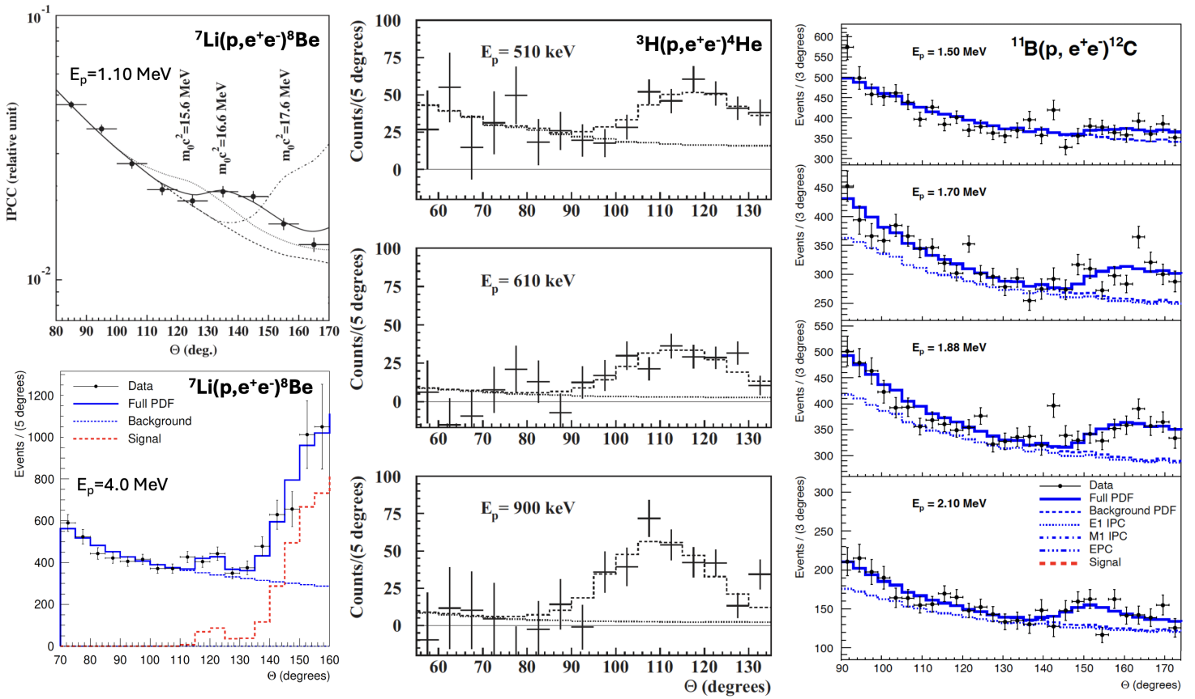
X17 Anomaly at ATOMKI in 2016
Proton beam on ⁷Li, ¹¹B, and ³H targets consistently produce excess e⁺e⁻ pairs with ~120° relative angle.
Could be consistent with new boson at 17 MeV?
Several follow up experiments have reported similar anomalies
Others have failed to reproduce
Can we make an X17 measurement at n_TOF?
https://cds.cern.ch/record/2920978/files/INTC-P-727.pdf

Slide 5
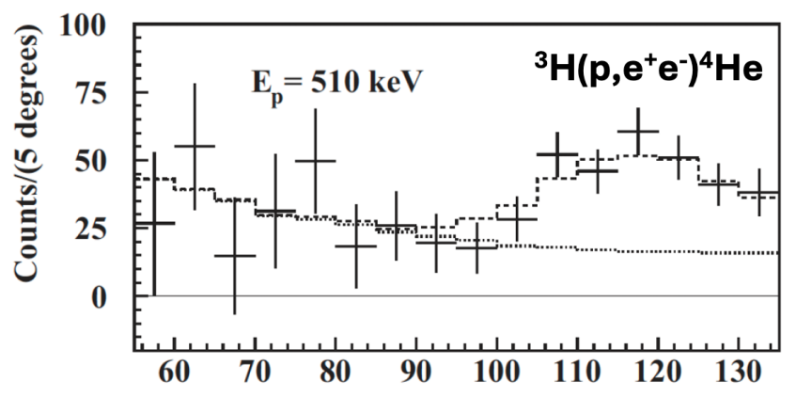

The Proposed X17 Particle
What can be measured at n_TOF?
Complementary & independent measurement to the original ATOMKI experiment using ³He target
Boson may be protophobic – larger cross-section in neutron beam → first X17 measurement with neutrons
(Excited State)
n
³He
⁴He*
De-excitation
Channels
20.58 MeV
Gamma Emission
𝛄
e⁺
Energy (MeV)
Internal Pair Conversion
20.6 MeV
De-excitation
e⁻
X17
e⁺
X17 emission and decay?
0 MeV
e⁻
DOI: 10.3390/universe10070285
⁴He
X17
e⁺
Signal: e⁺e⁻ at 120°
Phys. Rev. Lett. 116, 042501
𝜃
Characteristic emission angle 𝜃~120°
(Ground State)
e⁻

Slide 6
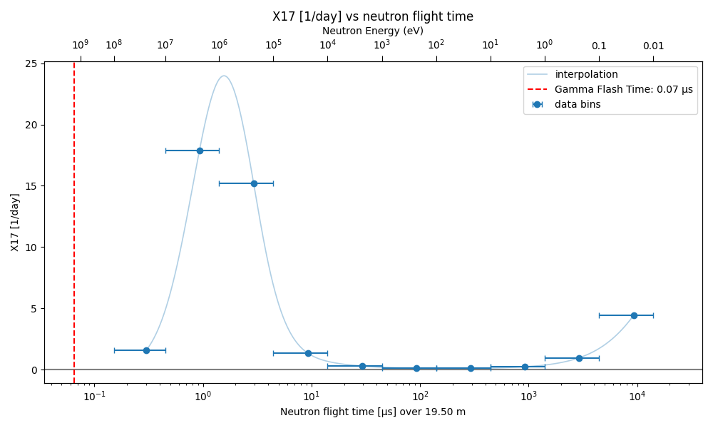
Where Do We Expect X17?
Peak around 1 MeV in neutron energy from high flux, ~80% of the expected yield
Smaller peak in thermal region due to increase in cross-section, ~20% of expected yield.

Slide 7
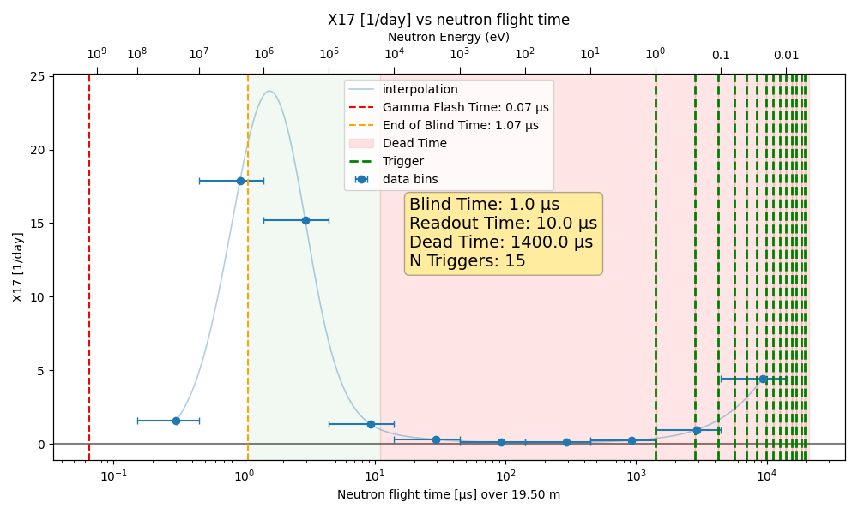
Where Do We Expect X17?
Peak around 1 MeV in neutron energy from high flux, ~80% of the expected yield
Smaller peak in thermal region due to increase in cross-section, ~20% of expected yield.
With proper triggering strategy, could be possible to read out both, but focus on high energy for now.

Slide 8
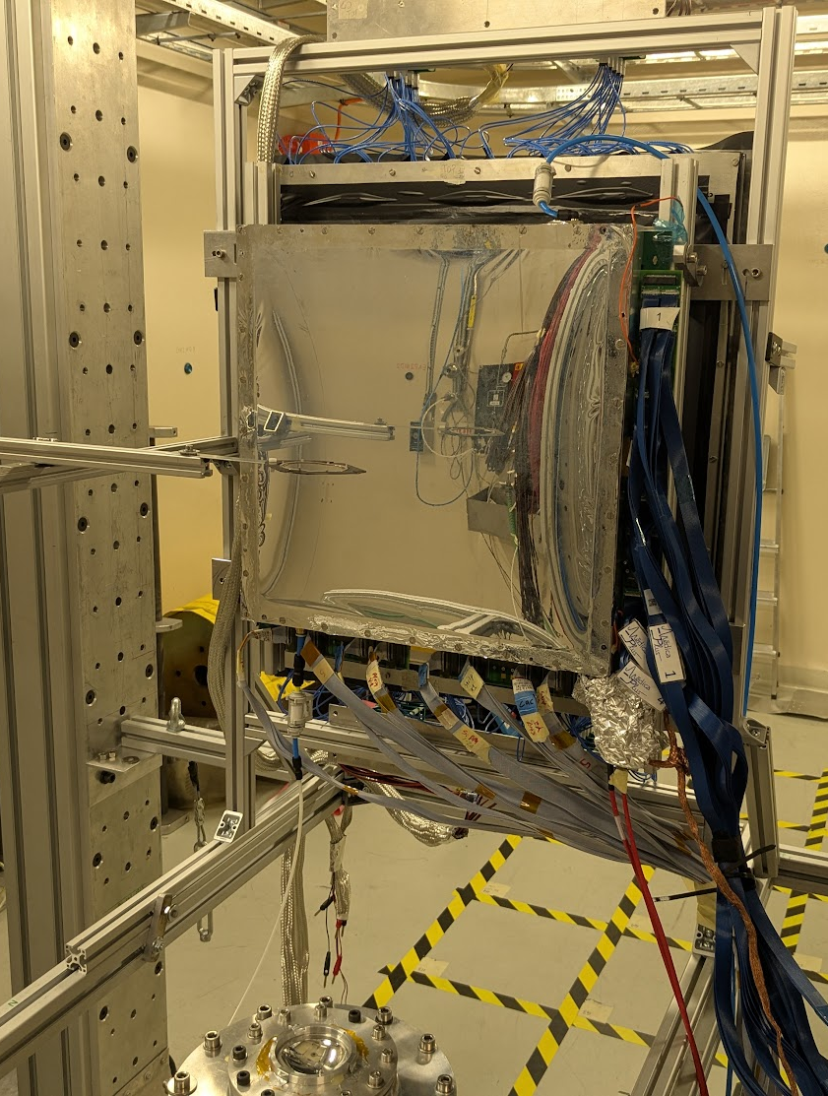
Experimental Setup
Micromegas
Four 40x40 cm resistive Micromegas detectors to measure e⁺e⁻ pair angles.
  3 cm drift volume for micro-TPC 3D reconstruction
  → Look for tracks pointing back to source
  1024 strips per detector, pitch of ~800μm
Read out of ~4k channels with DREAM electronics
MMs backed by scintillator walls – vertical strips
  Extra point for timing and tracking
e⁺
³He
e⁻
Scintillators
³He
neutrons
e⁻
Mylar window
Mesh
Readout
Notes:
Maybe the title like
Large-Area Micromegas Telescope – Commissioning & DAQ Development
Commissioned the first 40 × 40 cm² Micromegas detector of a 4-plane telescope for e⁺e⁻ pair measurements
→ Final setup will consist of four detectors arranged around the beam to measure e⁺e⁻ opening angles
deployed the complete DAQ architecture and synchronization scheme
→ Rapid implementation enabled early data-taking and system validation
→ Integrated 2D strip readout with top pixel layer for balanced x/y charge sharing
Enabled micro-TPC operation with a 3 cm drift gap
→ 3D track reconstruction capability
→ Reconstruction of tracks pointing back to the conversion source (ongoing optimization)
Developing a Geant4 simulation framework to optimize the detector gas mixture
→ Evaluate alternative mixtures to suppress γ-flash–induced background
→ Improve signal-to-background and enhance the e⁺e⁻ measurement sensitivity
Core contribution: Fast and robust DAQ setup significantly accelerated commissioning and made the measurement campaign feasible.

Slide 9
Micromegas at Saclay

Slide 10
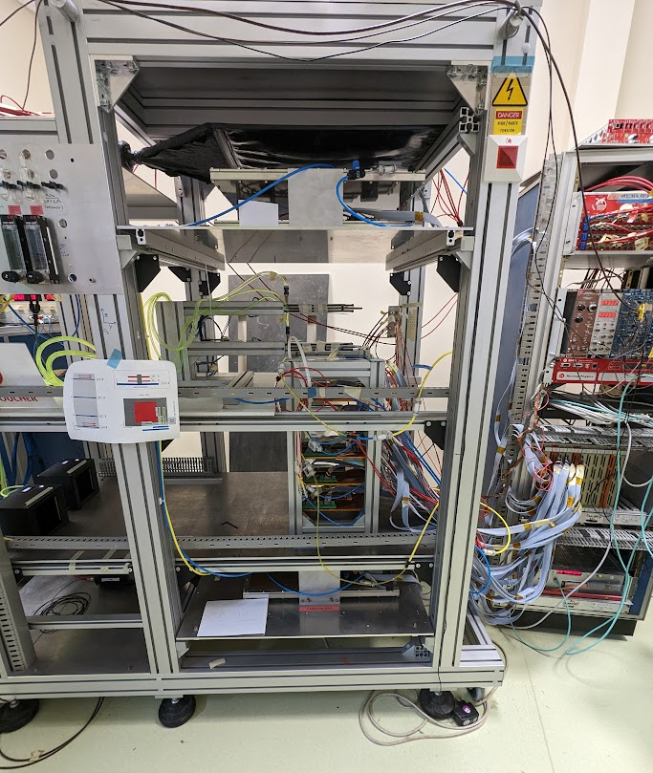
Micromegas Characterization in the Cosmic Test Bench @ CEA Saclay
Side View
4 Tracking Detectors
Cosmic Muon
MX17 Detector
2 Trigger Scintillators

Slide 11
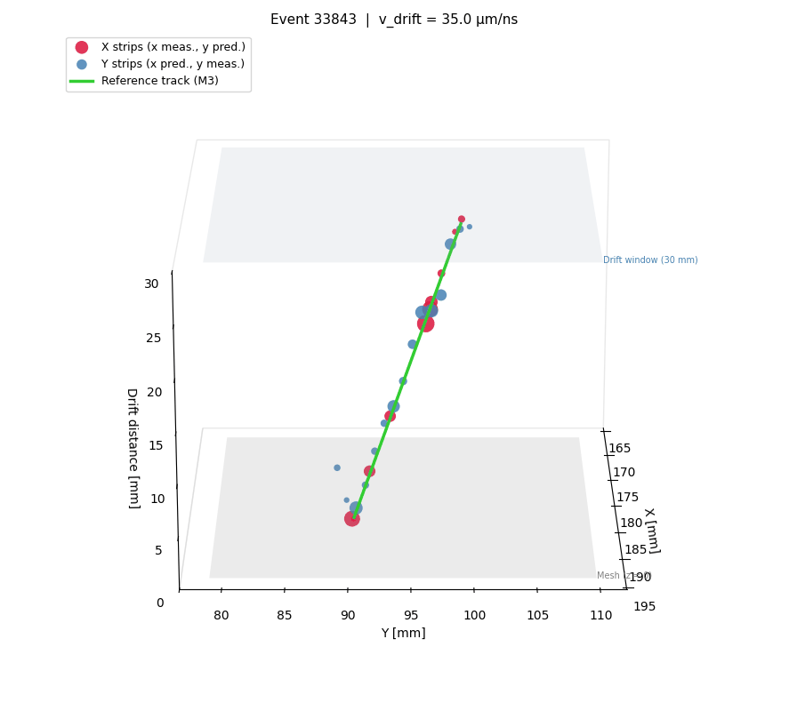
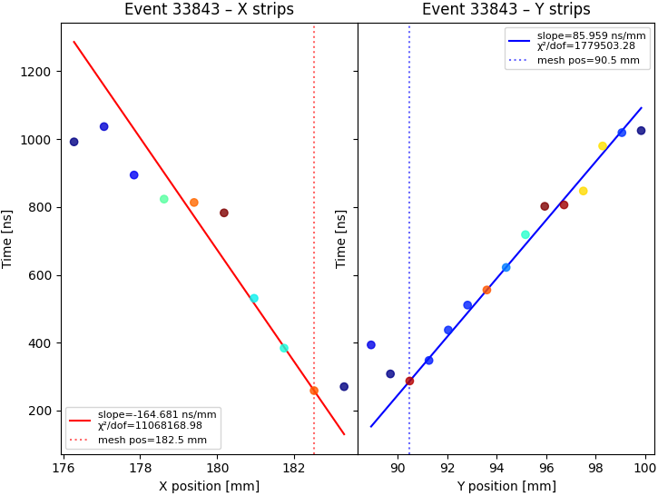
Can Reconstruct Tracks in μ-TPC Mode
Cherry-picking a nice event, can reconstruct a track in agreement with the reference tracker

Slide 12
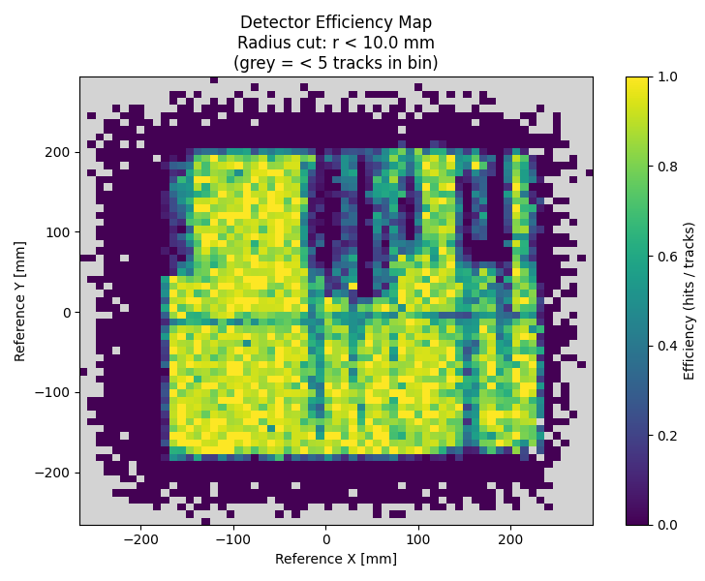
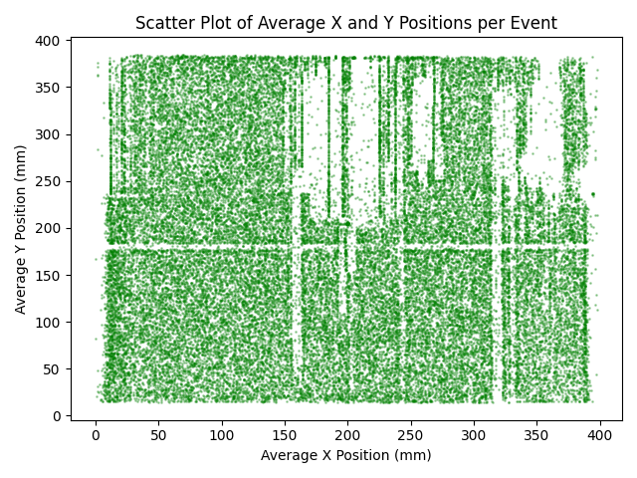
Detector 0 Is Efficient
Argon/Isobutane Gas (95/5)
30 mm drift gap
Aluminum Frame
Dead areas understood. Know how to fix in next detector iteration.
M4 connector edge not making contact
Resistive strips broken
(no HV here)

Slide 13
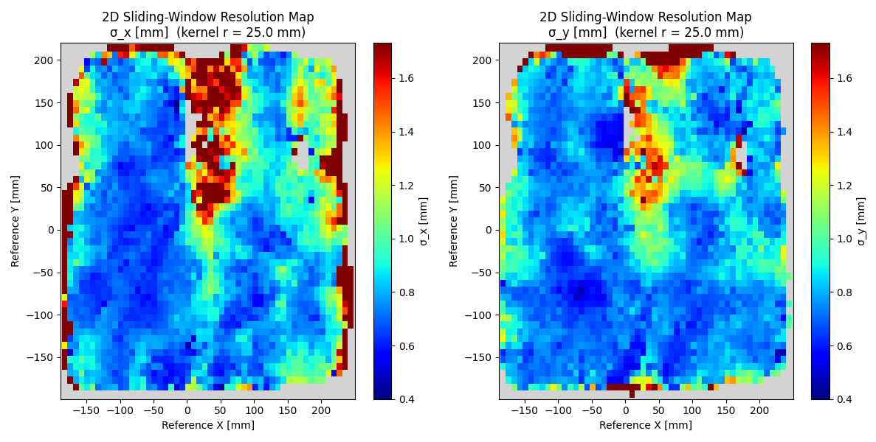
Detector 0 Spatial Resolution is Reasonable
Argon/Isobutane Gas (95/5)
30 mm drift gap
Aluminum Frame
Reference tracker only has ~500μm spatial resolution.
Good that most of the detector is around 500μm, hopefully better in reality

Slide 14
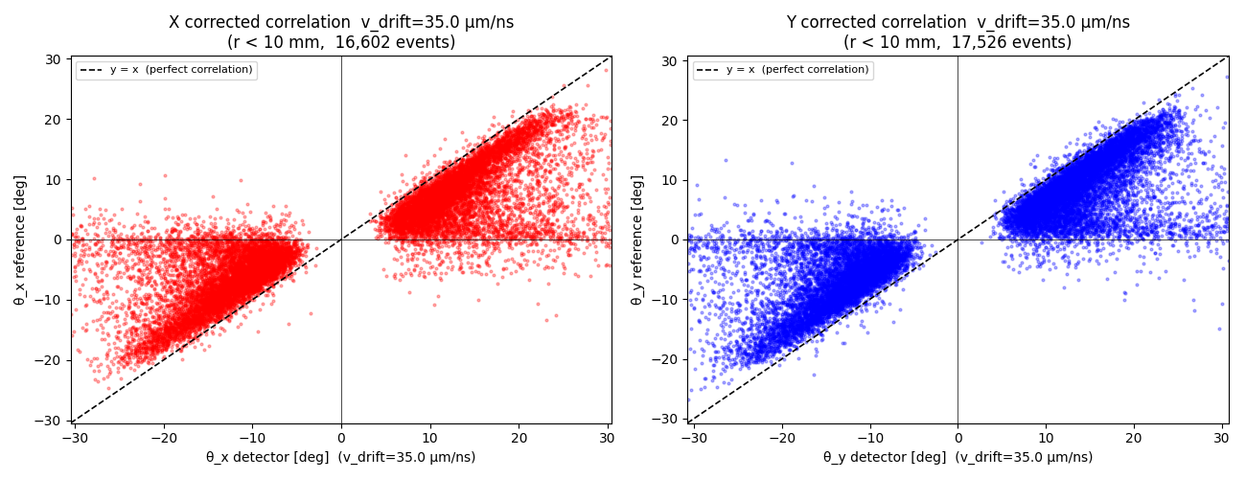
Track Angles Reconstructed
Argon/Isobutane Gas (95/5)
30 mm drift gap
Aluminum Frame
The reconstructed track angles correlate with the reference track angles.
Offset of the correlation is interesting, possibly an algorithmic issue?

Slide 15
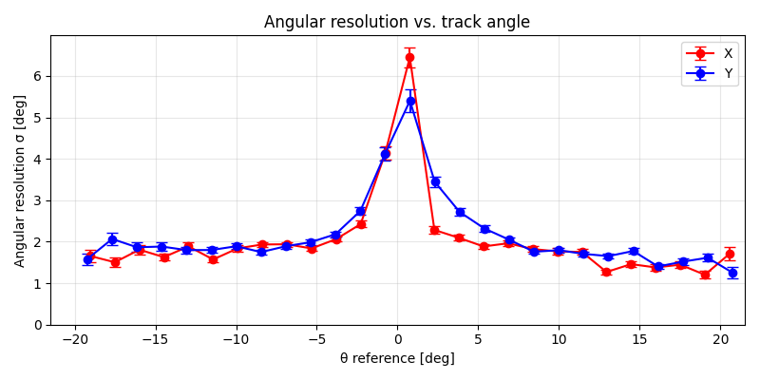
Angular Resolution ~2°
Argon/Isobutane Gas (95/5)
30 mm drift gap
Aluminum Frame
Angular resolution of the detector is about 2°.
Understandably worse at low angles (normal to the detector).
Possible to do a bit better with improved reconstruction algorithm.

Slide 16
February Beam Test

Slide 17
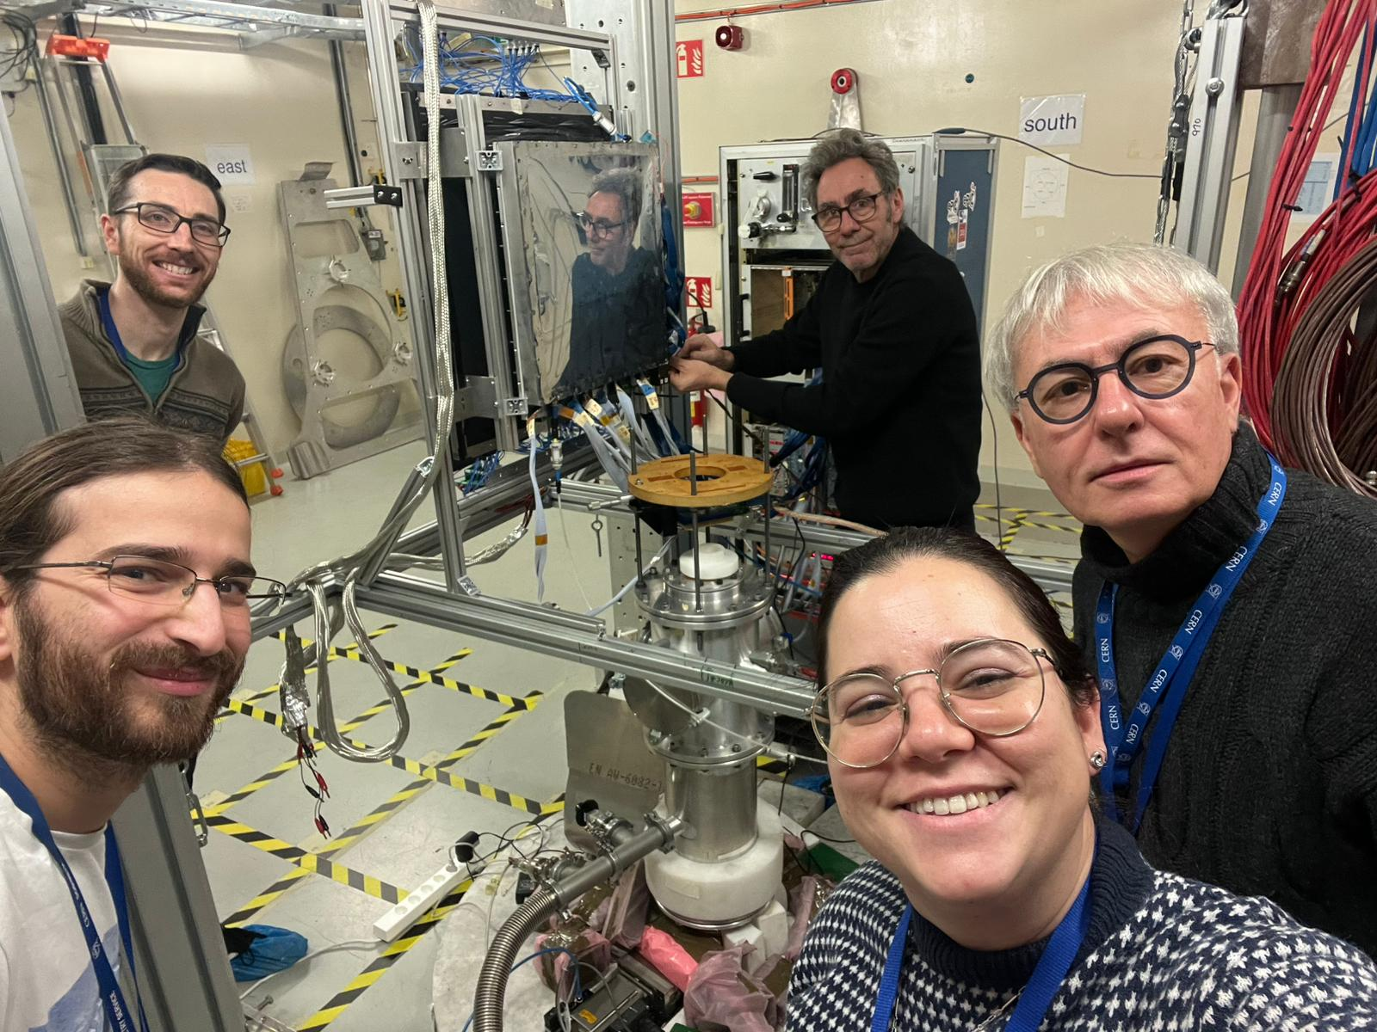
February Beam Test
Detector 0 on beam for a month, tested a variety of variables
Gases (all non-flammable)
  Argon/CF4/Isobutane 88% / 10% / 2%
  Helium/Ethane 96.5% / 3.5%
  Argon/CF4/CO2 45% / 40% / 15%
  Argon/CF4 90% / 10%
  Argon/CO2 70% / 30%
Drift Gaps
  30 mm
  11 mm
  6 mm
Detector Frames
  Aluminum
  Carbon
Targets

Slide 18
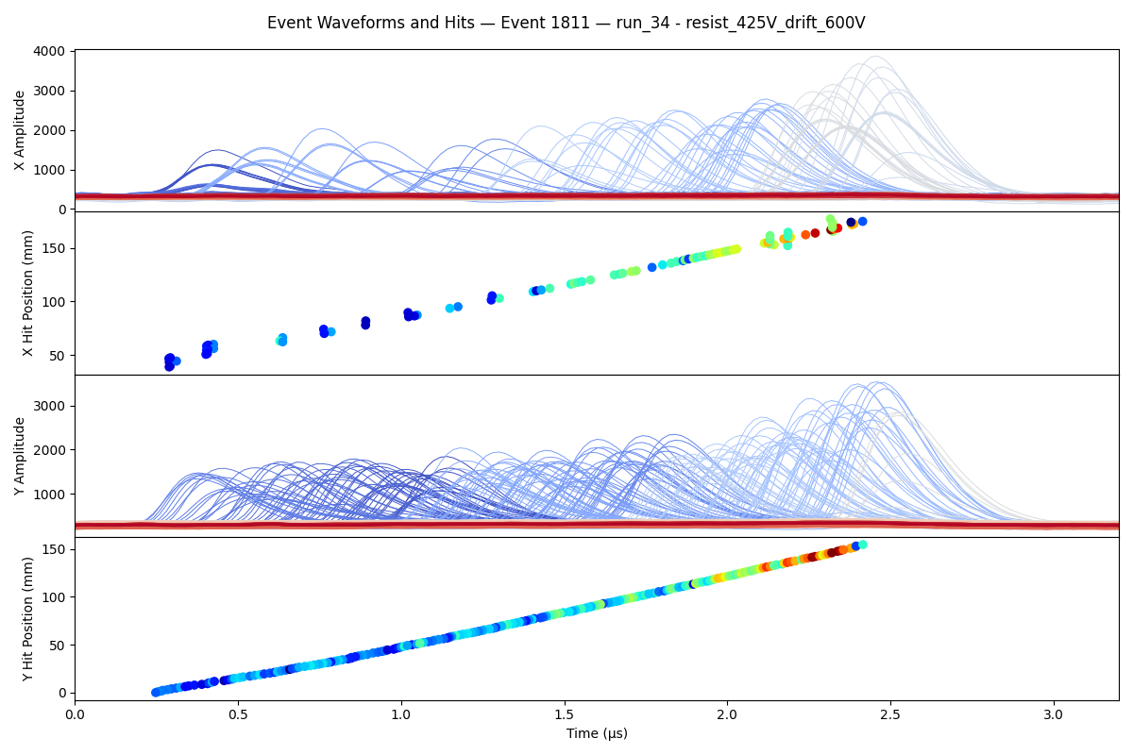
Isolated Track in Beam (Thermal Region)
Helium Ethane Gas (96.5/3.5)
30 mm drift gap
Aluminum Frame
Naively, looks like exactly what we would expect from single track event
In thermal neutron region
Not sure what particle left this track (high dE/dx)

Slide 19
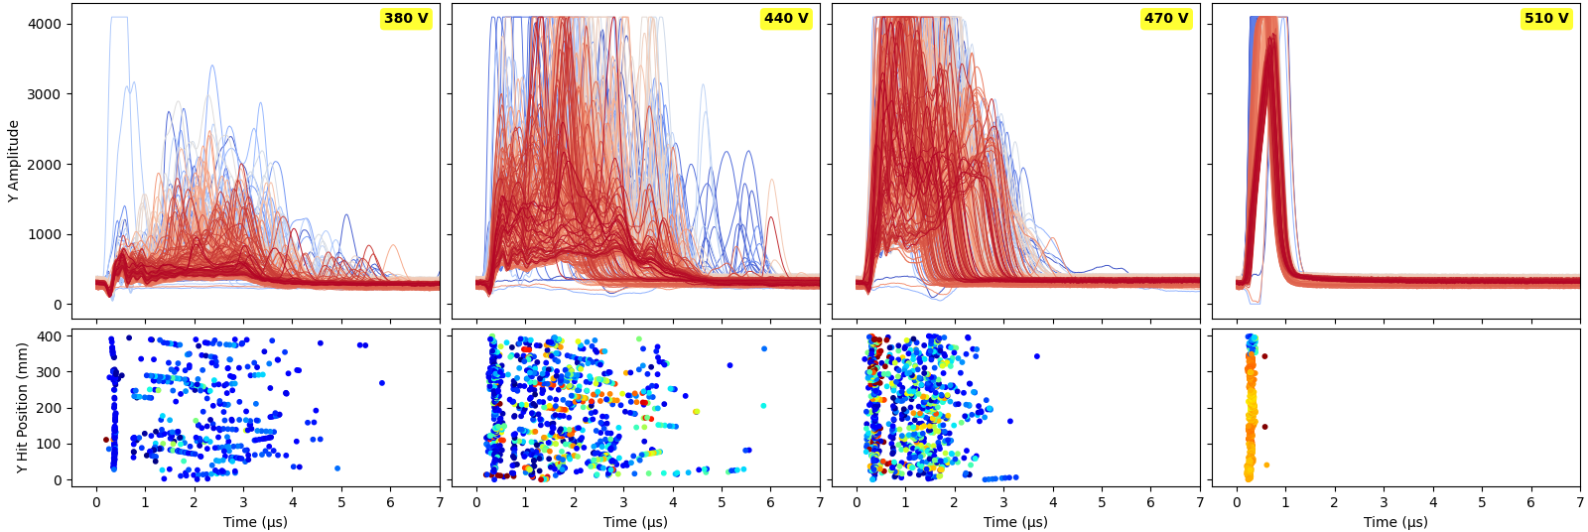
Micromegas in Gamma Flash – DAQ Saturation
Helium Ethane Gas (96.5/3.5)
30 mm drift gap
Aluminum Frame
When amplification field is too high, DAQ saturates and sees no hits
During flash, signals around -15 mV.
Much too large for our DREAM DAQ!
Larger Amplification Field
Many hits
See some hits
No hits at late times
DAQ saturation

Slide 20


Big Question: Can We Detect Signal Before DAQ Saturation?
At what Resist Bias HV do we begin to see ~5-15 MeV electron/positrons? (MIPs)
At what Resist Bias HV does the DREAM DAQ saturate?
Need Calibration!
Electron Efficient
Dream Saturates
We can make the measurement
Amplification (Resist) HV
We can not make the measurement
Dream Saturates
Electron Efficient
Amplification (Resist) HV

Slide 21
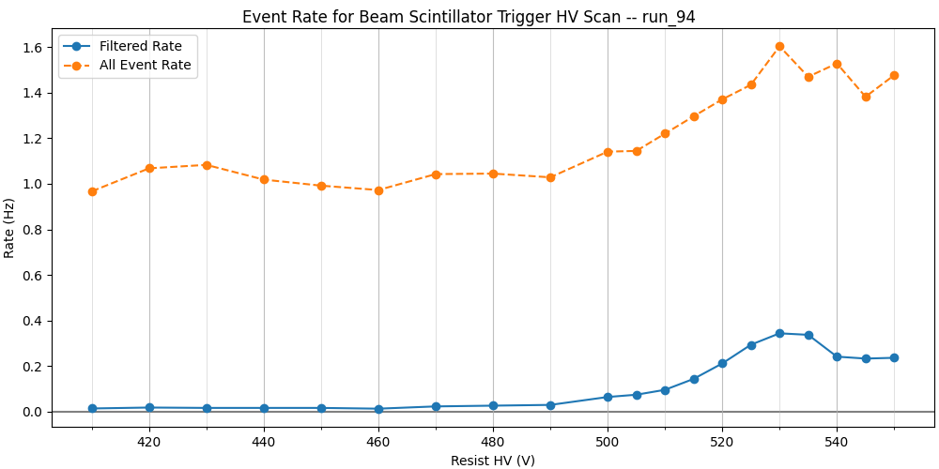
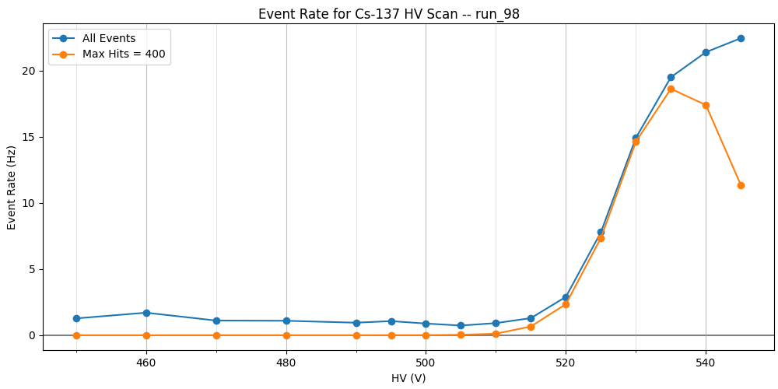
Calibration Schemes (Helium/Ethane)
Don’t really trust either of these calibration methods, but they’re all we have
Run with beam, ignore gamma flash triggers and focus on thermals
Trigger on one of the scintillator SiPM
Reject any event with more than 8 strips hit
If any strip is hit, count as a coincidence
Run without beam, self-triggering with Cs-137
Select events with less than 400 hits to filter out full detector discharging

Slide 22
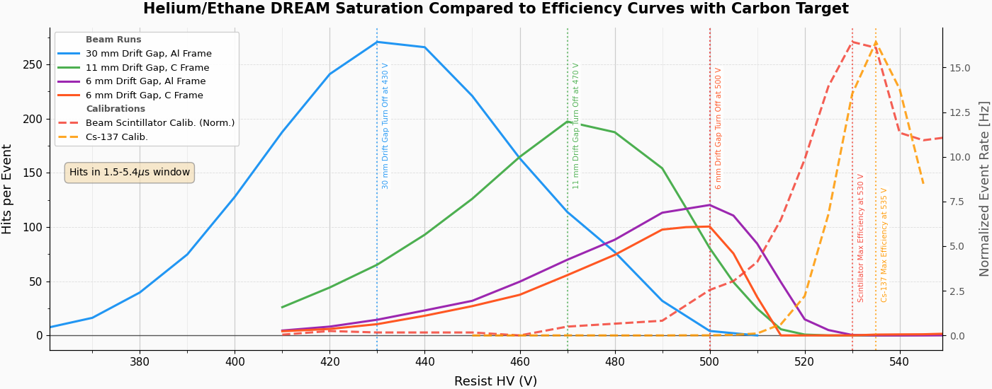
DREAM Saturation in Helium/Ethane
Compare turn off curves in Helium/Ethane (96.5/3.5) to turn on calibration curves. Not quite overlap!
Notes:
We don’t have any plateau….Cazzo!

Slide 23
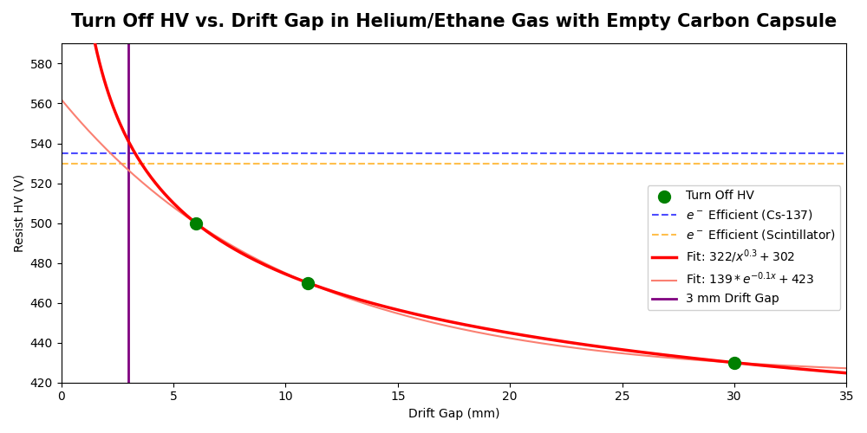
Solution: Smaller Drift Gap?
Firm Conclusion: At lower drift gap, DREAM DAQ survives to higher HV.
Question: Can we extrapolate this dependence? Will we survive to e⁺e⁻ efficiency with 3mm drift gap?

Slide 24
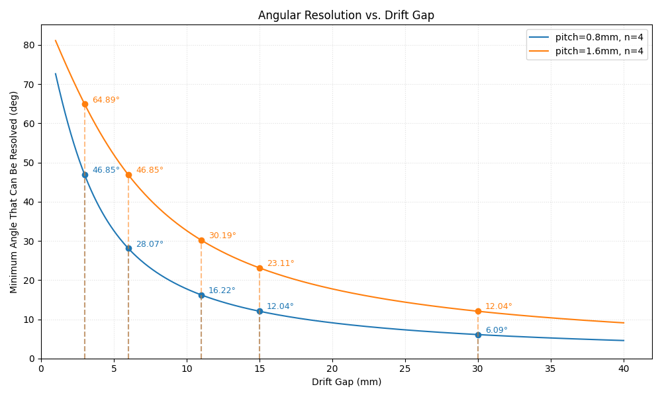
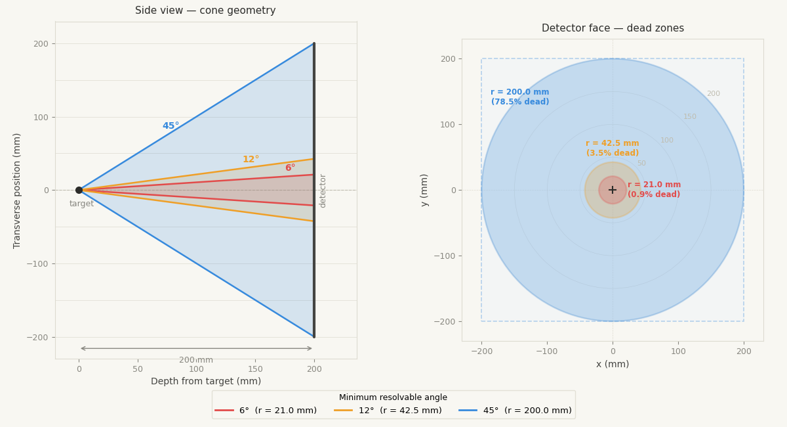
The Cost of Lower Drift and Fewer Strips
May have to reduce drift gap to keep DREAM alive.
The consequence is degrading angular resolution on micro-TPC mode.
(May also have to reduce number of strips read out due to DAQ availability.)

Slide 25
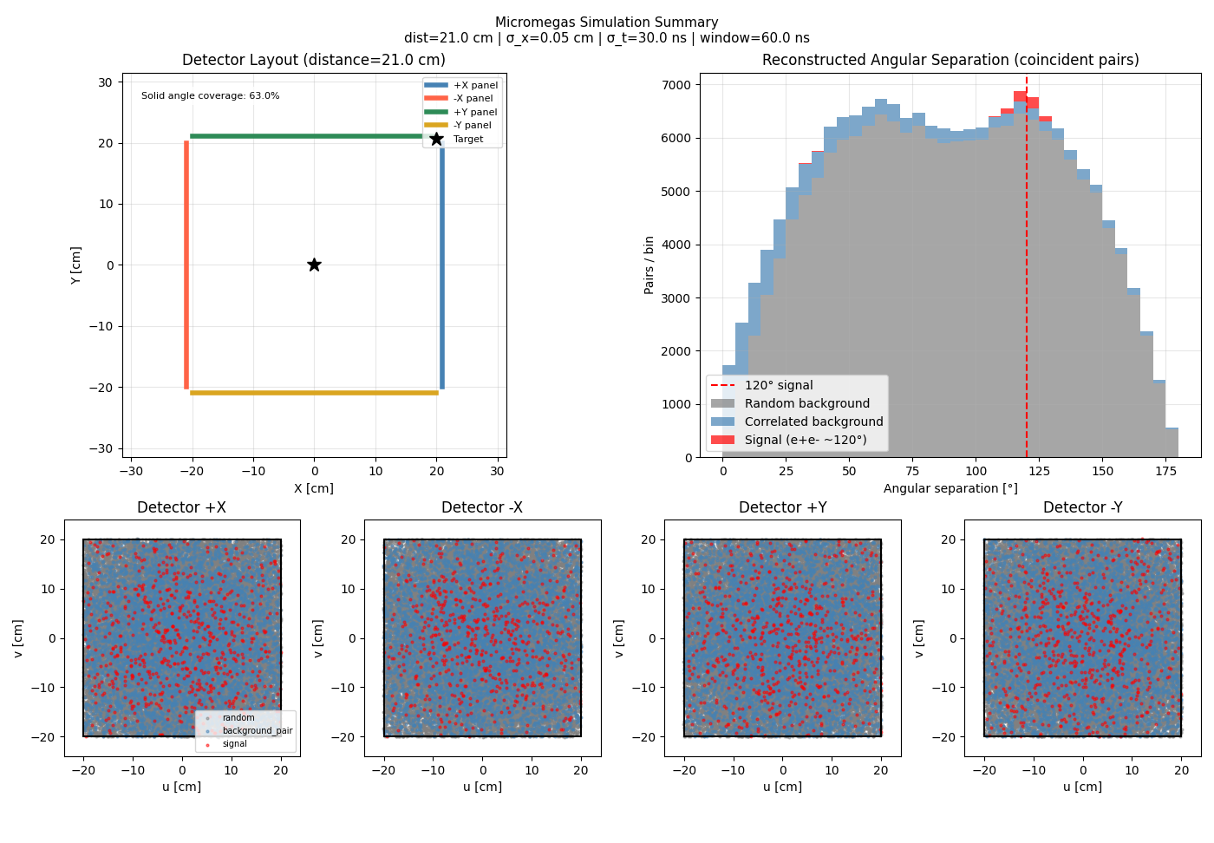
Hit Mode?
If we give up on tracks, can we operate in hit mode?
Highly dependent on input parameters, but should be able to simulate pair angular separation distribution.
See if hit mode is feasible – combinitorial background vs signal

Slide 26

Going Forward
Key Problem: DAQ Saturation Near Gamma Flash
Possible Solutions:
Divert output signals to ground for start of flash
Counteract the signal on the MM detector
Find a “magic gas” which is less sensitive
Use a small drift gap and go Hit Mode
Consider a thermal measurement (~20% of statistics)
Key Challenges:
DREAM DAQ saturation
Logistics – Need to build new DAQ and detectors at Saclay. Test and characterize.
Need to think of a reliable way to calibrate detectors at n_TOF
May Test
May Test

Slide 27
Backup

Slide 28
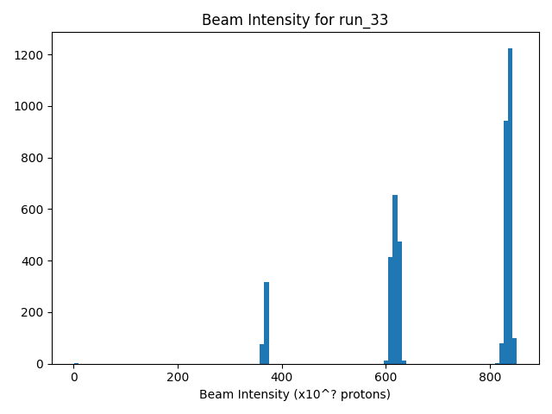
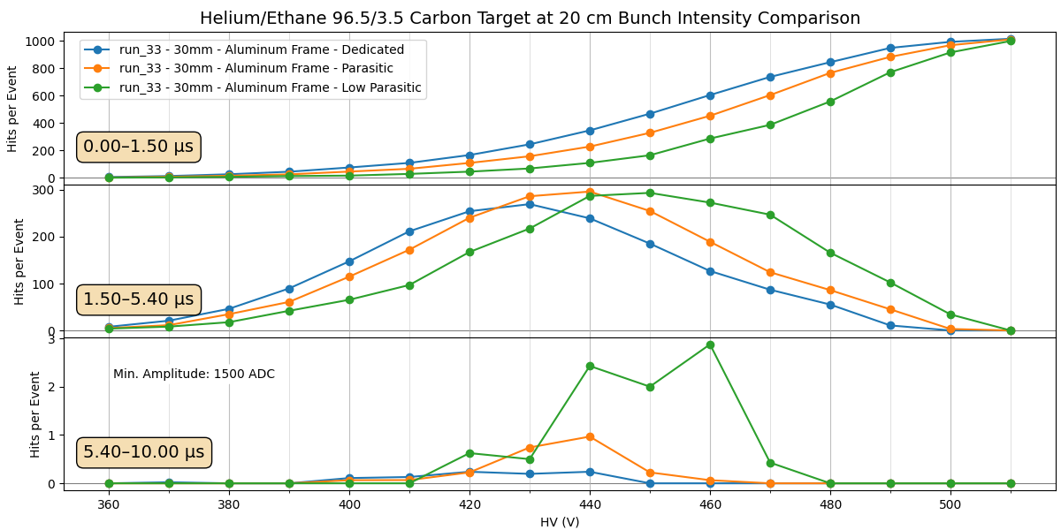
Turn Off Later for Lower Intensity Bunches
10^10

Slide 29
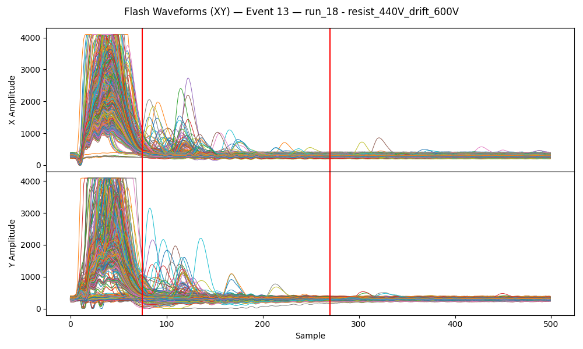
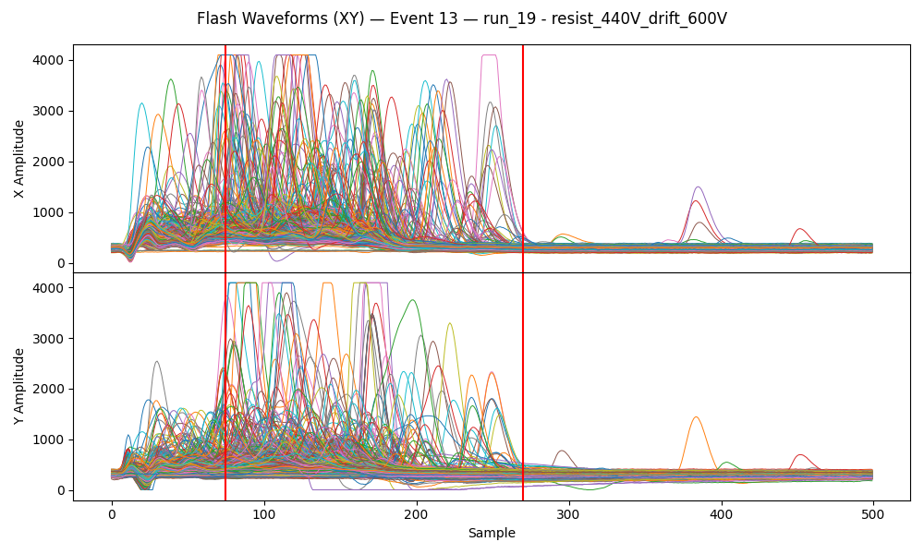
Helium vs Argon Trade-off
Argon Gas - Timepix!
Helium Gas - No Target
Large prompt signal at flash
No large flash signal, many signals after

Slide 30
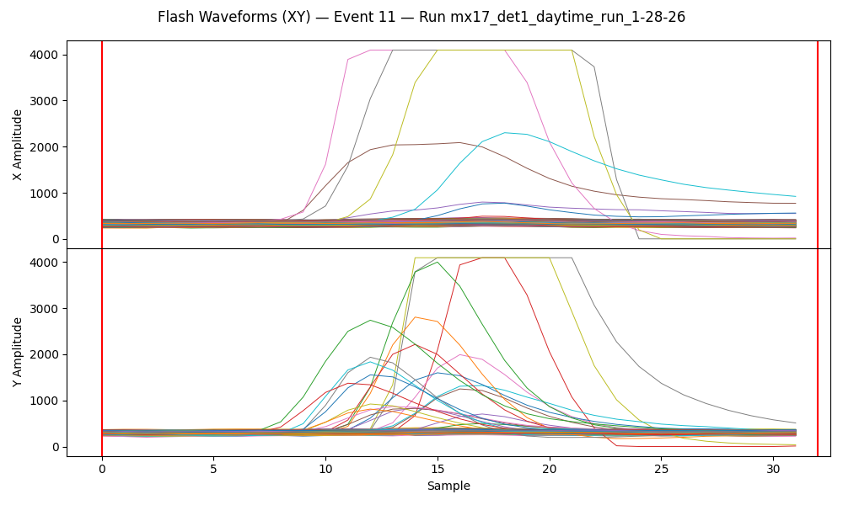
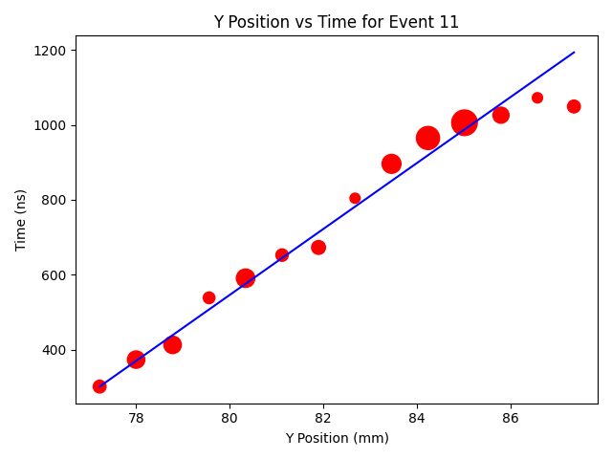
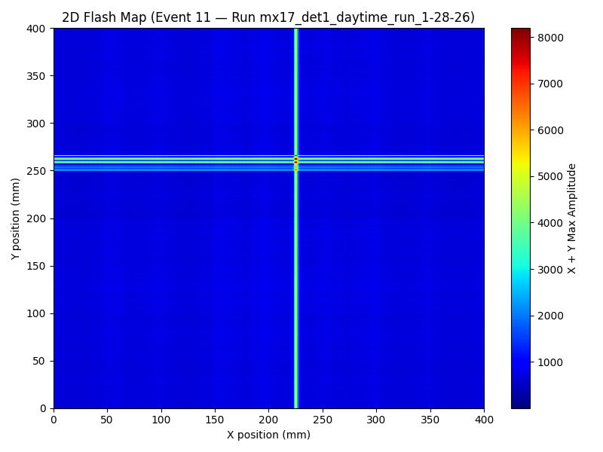
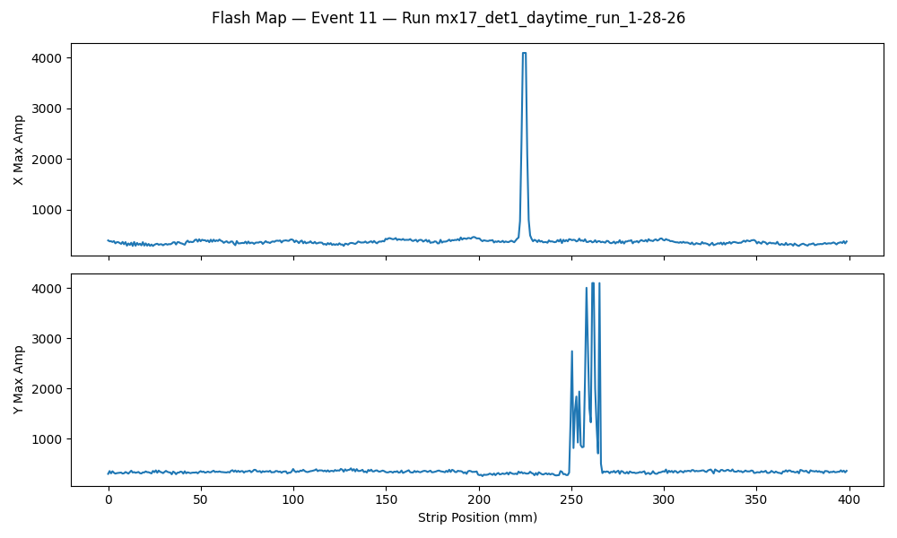
MX17 Detector 0 is Alive
Single muon event
From Saclay cosmic bench.
See what we would expect for muon tracks in micro-TPC
M4 connector edge not making contact
Resistive strips broken
(no HV here)

Slide 31
Focus Has Been on High Energy
It looks like ~20% of statistics should be in thermals.
We haven’t spent time exploring a backup thermal measurement!
Unclear what is possible. Will DREAM even un-saturate in time?
Could test in May but would need to commit time.

Slide 32
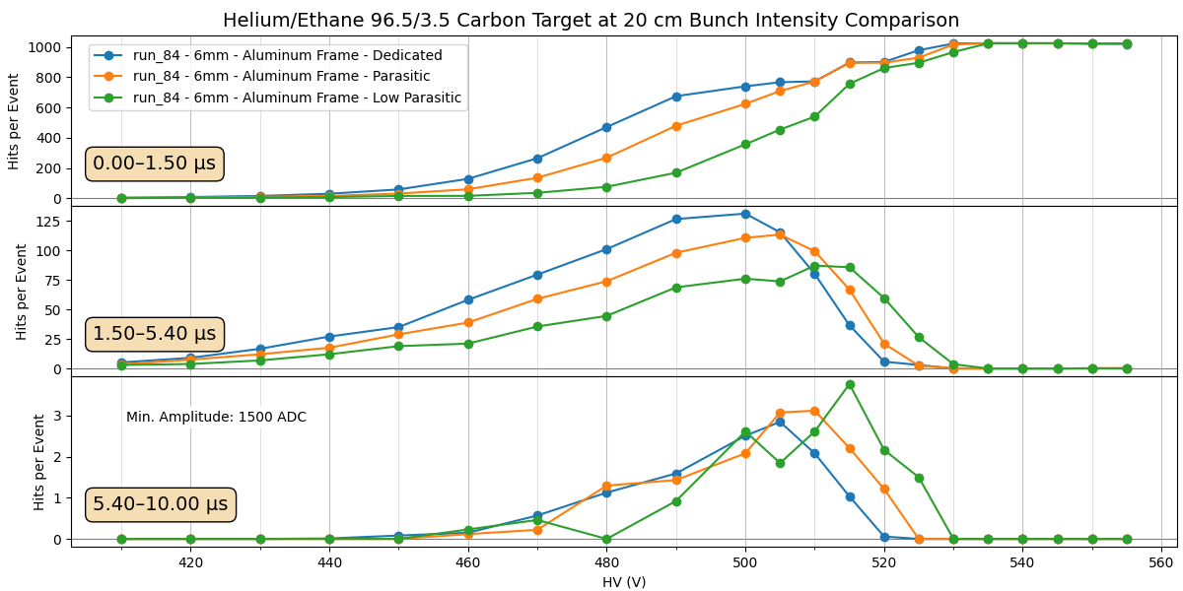
Bunch Intensity in 6mm Drift

Slide 33
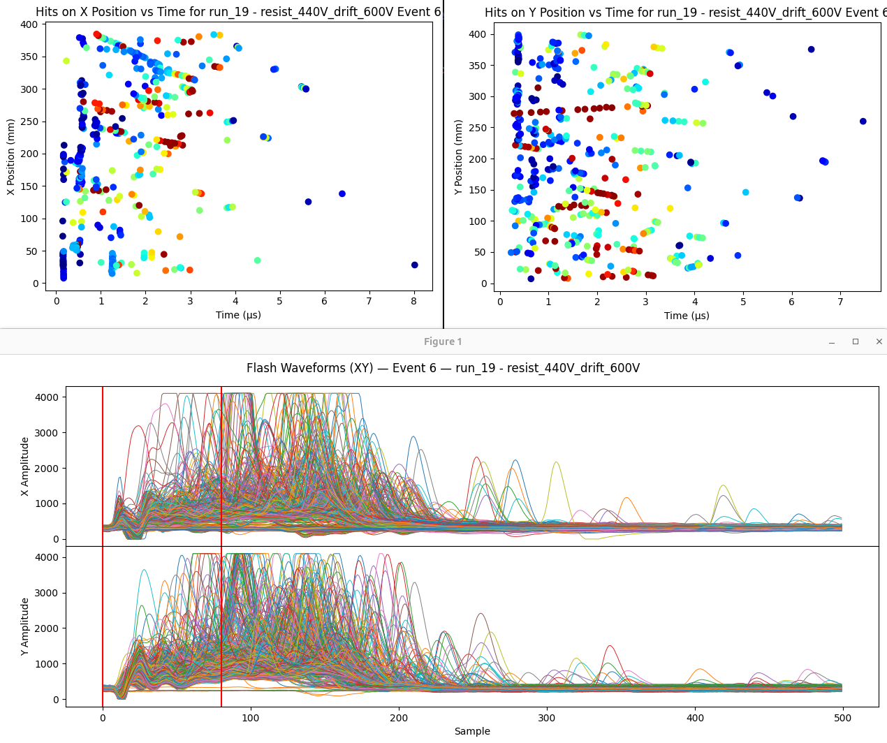
Experimental Challenges
Unique background environment
  Pulsed proton beam on target. All relativistic neutrons arrive together along with a “gamma flash”
  Huge multiplicity of particles hit detector in very short time window, incredibly difficult to decouple
  Need to find way to reduce background and retain signal (gas choice, amplification field, drift field, etc)
Race to make measurement
  Experiment was designed for μRwell detectors, but these faced logistical issues
  Micromegas design, production and implementation has been
Hope to make a definitive measurement!
potential tracks

Slide 34
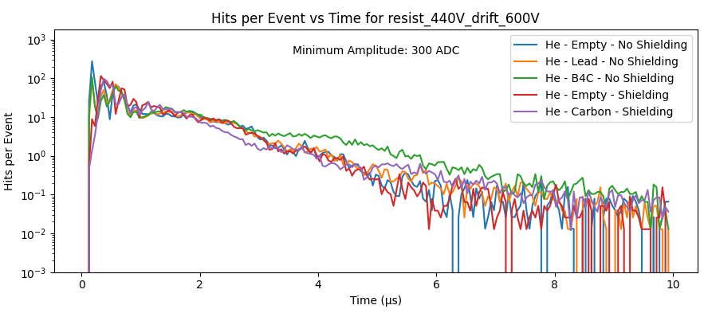
Rough Spectrum

Slide 35
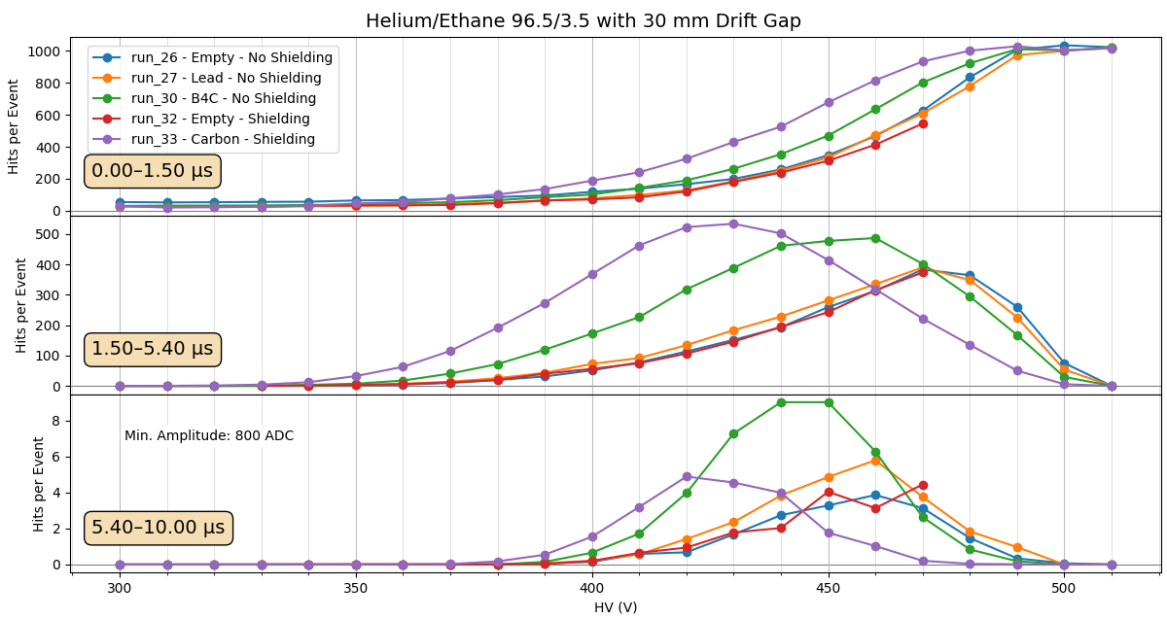
He/Ethane 30mm Targets

Slide 36
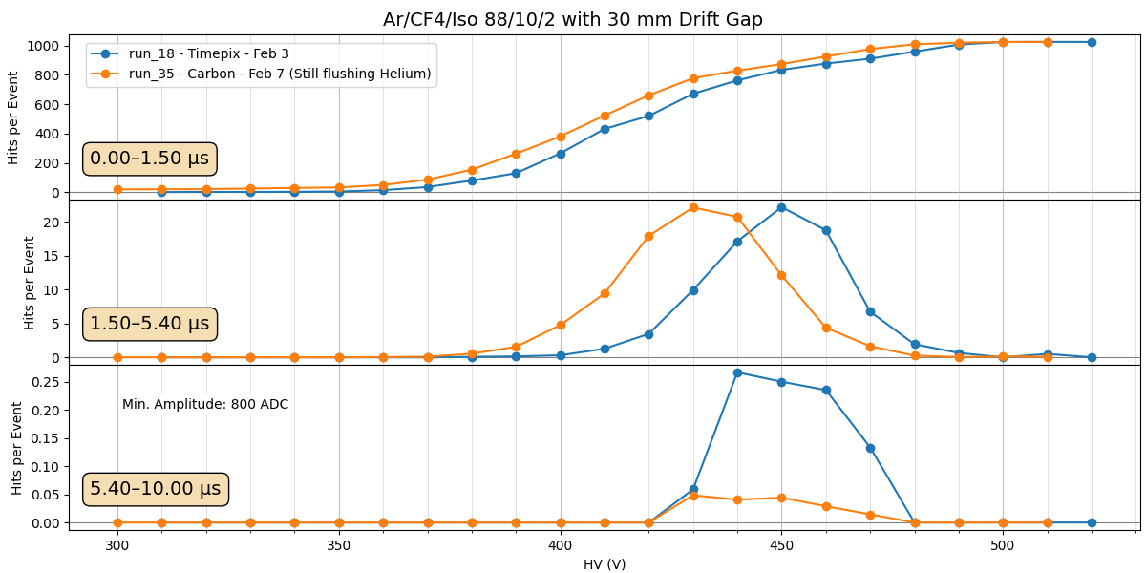

Slide 37
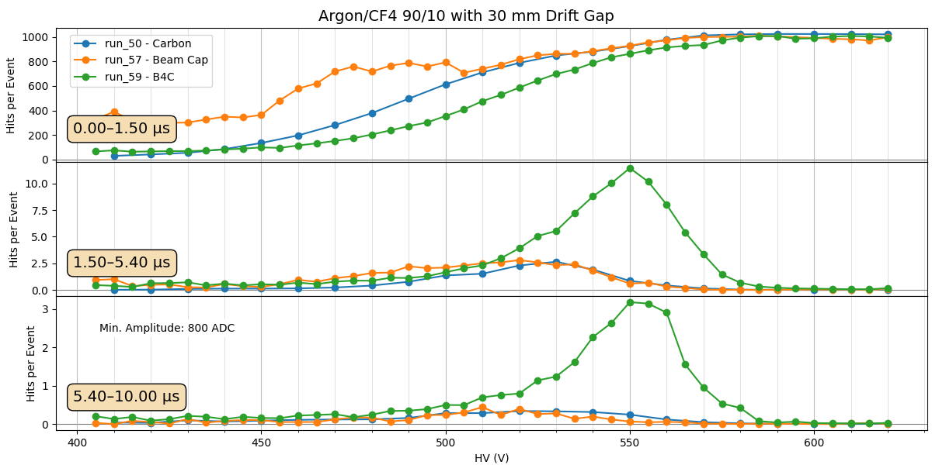

Slide 38
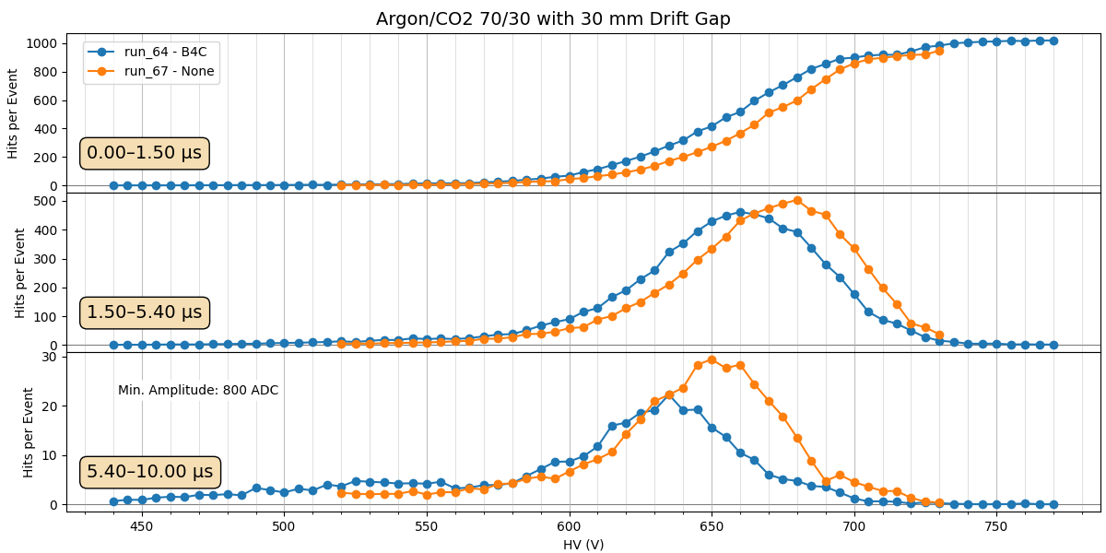

Slide 39
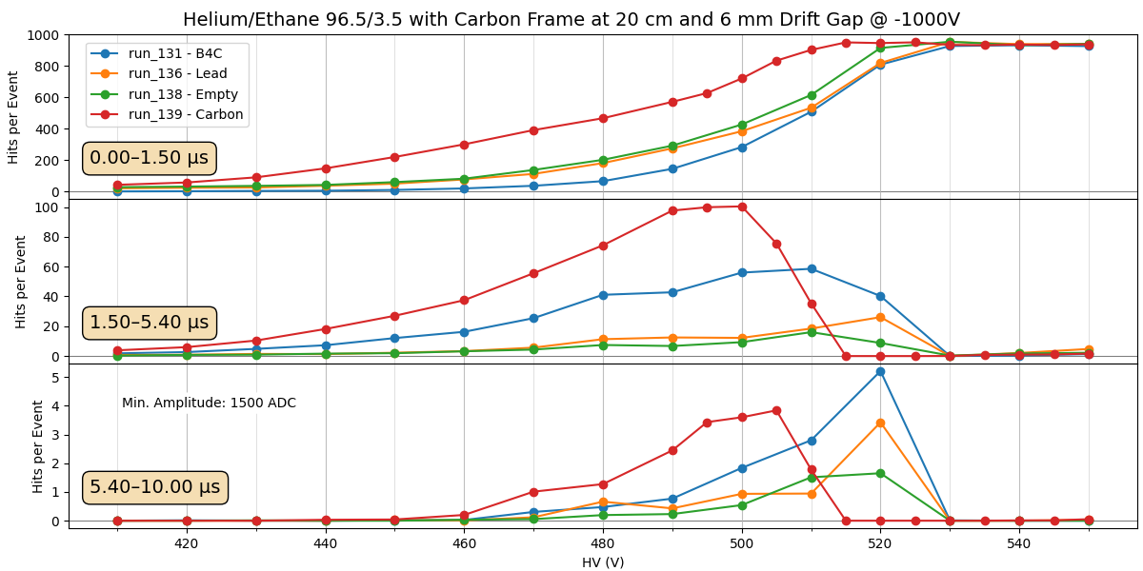

Slide 40
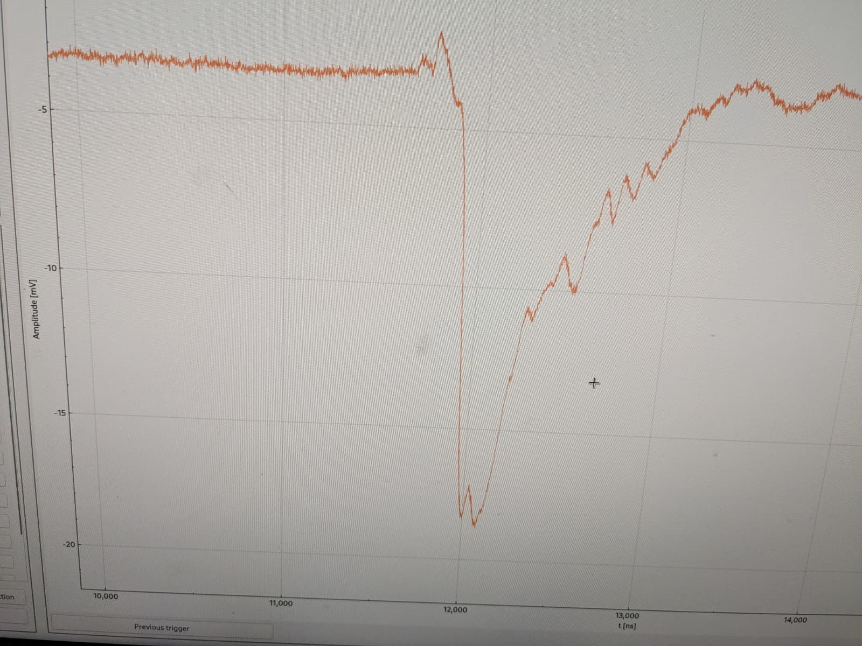
MM Flash in n_TOF DAQ

Slide 41
